Slide 1

Programming Fundamentals Project
Presented by: Syeda Bismah, Abeeha zaid, Tanzeela Javed.
Roll Number: F2024266530, F2024266502, F2024266517.

Slide 2
About My Project
Overview
This program is designed to assist library managers in efficiently handling their tasks.
Key Features:
Manage student records.
Track borrowed books:
The librarian can enter the book's name, and the program will display who borrowed it.
Add and view helpful notes:
The notes feature ensures the librarian stays organized and remembers important details.

Slide 3
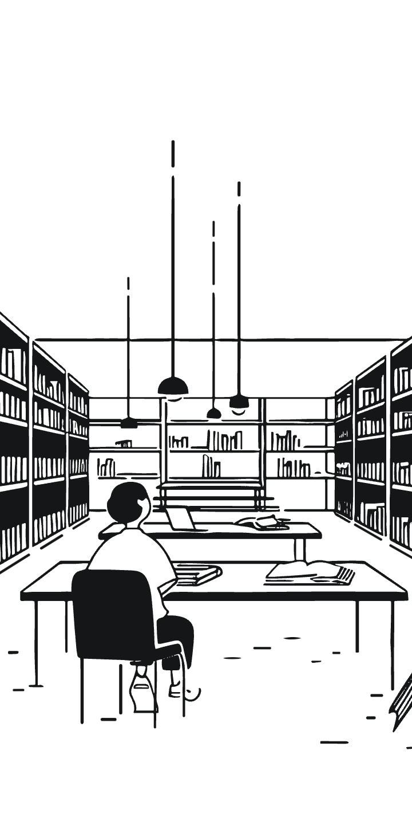
About My Project
Additional Features
1. Learning Commons Booking:
The librarian can manage bookings for learning commons.
The program keeps track of:
The total number of available learning commons.
Booking details like time and learning commons number.
The booking list can be viewed later for reference.
2. Why This Program?
Simplifies the librarian's tasks.
Saves time and reduces errors.

Slide 4
Introduction to My Code (Part 1)
Development Environment
Programming Concepts Applied
Tool Used: Dev-C++
Modular Programming: Using functions to break the code into smaller, reusable parts.
Boilerplate Code: Template code for basic structure.
Conditional Statements and Loops: To handle decisions and repetitive tasks.

Slide 5

Introduction to My Code (Part 2)
Data Structures Used
Arrays: For managing collections of data efficiently.
Structs: To organize and group related data.

Slide 6
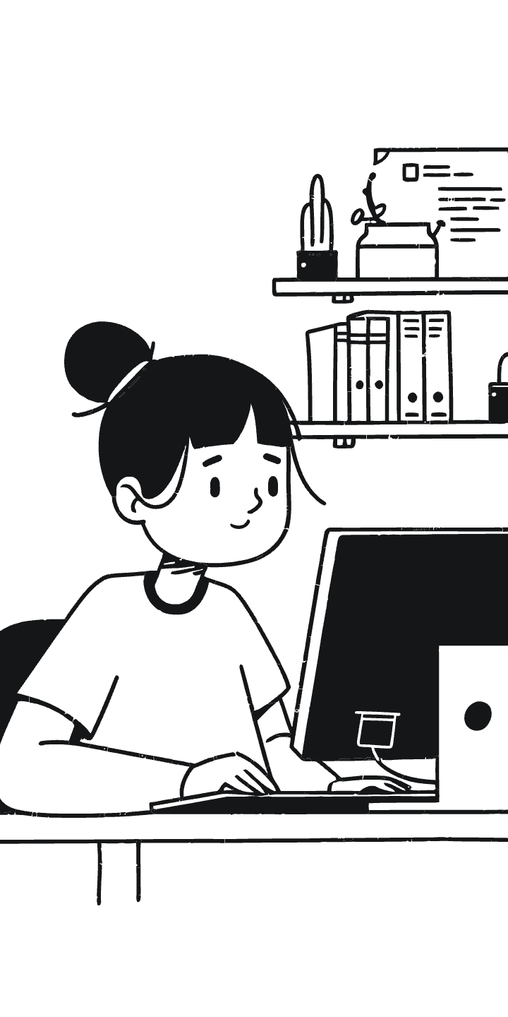

Code Demonstration
Let Me Walk You Through My Code
In this section, I will explain the structure and functionality of my program.
A detailed step-by-step walkthrough of my code will highlight:
How the features were implemented.
The logic behind the program's functions.
I will also present a video demonstration to showcase the program's features in action.

Slide 7

ANY QUESTIONS???

